Slide 1

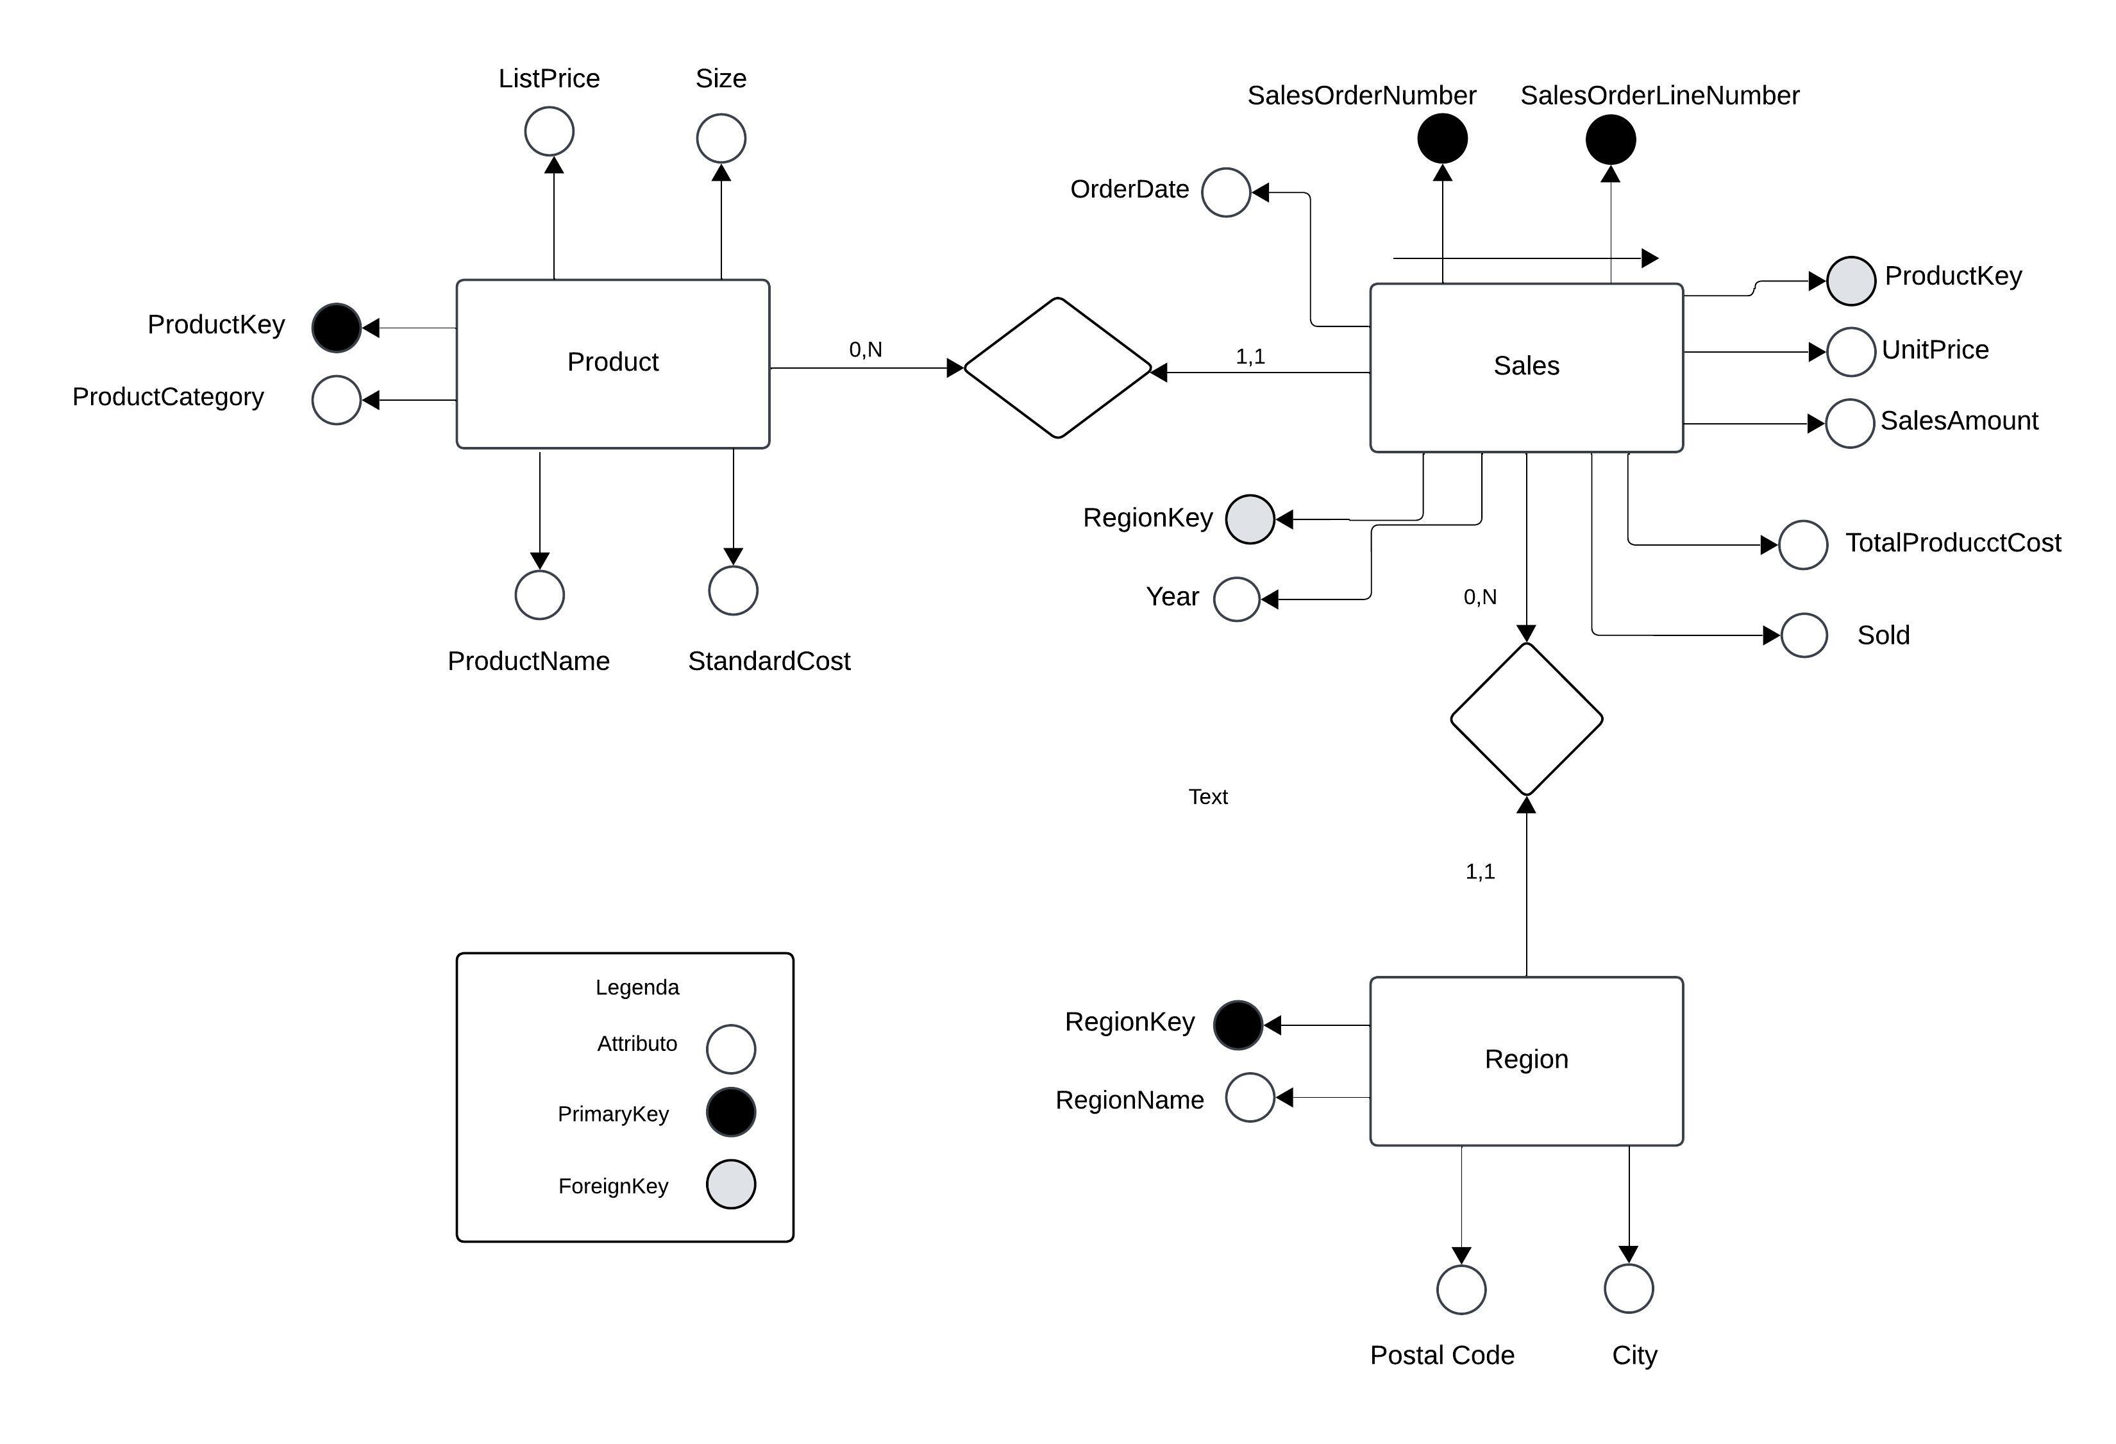
P Progettazione Concettuale

Slide 2
P Progettazione Logica
Sales
SalesOrderNumber INT (PK)
SalesOrderLineNumber INT (PK)
Sold BOOLEAN
SalesAmount DECIMAL
OrderDate DATE
Year INT
UnitPrice DECIMAL
TotalProductCost DECIMAL
ProductKey INT(FK)
RegionKey INT (FK)
Product
ProductKey INT (PK)
ProductCategory VARCHAR
ProductName VARCHAR
StandardCost DECIMAL
ListPrice DECIMAL
Size VARCHAR
Region
RegionKey INT (PK)
RegionName VARCHAR
City VARCHAR
PostalCode VARCHAR

